Slide 1
Functions
陳建良

Slide 2
Introduction to Functions
Most programs perform tasks that are large enough to be broken down into several subtasks.
For this reason, programmers usually break down their programs into small manageable pieces known as functions.
A function is a group of statements that exist within a program for the purpose of performing a specific task.
Instead of writing a large program as one long sequence of statements, it can be written as several small functions, each one performing a specific part of the task.
These small functions can then be executed in the desired order to perform the overall task.

Slide 3
This approach is sometimes called divide and conquer because a large task is divided into several smaller tasks that are easily performed.

Slide 4
Benefits of Modularizing a Program with Functions
Simpler Code
Code Reuse
Better Testing
Faster Development
Easier Facilitation of Teamwork

Slide 5
Void Functions and Value-returning Functions
There are two types of functions: void functions and value returning functions.
When you call a void function, it simply executes the statements it contains and then terminates.
When you call a value-returning function, it executes the statements that it contains, then returns a value back to the statement that called it.
The input function is an example of a value-returning function.

Slide 6
Function Names
Just as you name the variables that you use in a program, you also name the functions.
Python requires that you follow the same rules that you follow when naming variables, which we recap here:
You cannot use one of Python’s key words as a function name.
A function name cannot contain spaces.
The first character must be one of the letters a through z, A through Z, or an underscore character (_).
After the first character you may use the letters a through z or A through Z, the digits 0 through 9, or underscores.
Uppercase and lowercase characters are distinct.

Slide 7
Here is the general format of a function definition in Python:
def function_name():
statement
statement
etc.
An example of a function.
def message():
print('I am Arthur,’)
print('King of the Britons.’)
To execute a function, you must call it.
message()

Slide 10
Flow of Execution

Slide 11
Flow of Execution

Slide 12
Flow of Execution

Slide 13
Flow of Execution

Slide 14
Flow of Execution

Slide 15
Flow of Execution

Slide 16
Flow of Execution

Slide 17
Flow of Execution

Slide 18
Flow of Execution

Slide 19
Flow of Functions with Functions

Slide 20
Flow of Functions with Functions

Slide 21
Flow of Functions with Functions

Slide 22
Flow of Functions with Functions

Slide 23
Flow of Functions with Functions

Slide 24
Flow of Functions with Functions

Slide 25
Flow of Functions with Functions

Slide 26
Flow of Functions with Functions

Slide 27
Flow of Functions with Functions

Slide 28
Flow of Functions with Functions

Slide 29
Multiple Functions
def hello():
print (“Hello there!”)
def goodbye():
print (“See ya!”)
hello()
goodbye()

Slide 30
Multiple Functions
In fact, it is common for a program to have a main function that is called when the program starts.
The main function then calls other functions in the program as they are needed.

Slide 36
Indentation in Python

Slide 37
Local Variables
A local variable is created inside a function and cannot be accessed by statements that are outside the function.
Anytime you assign a value to a variable inside a function, you create a local variable.
Different functions can have local variables with the same names because the functions cannot see each other's local variables.

Slide 38
An error will occur if a statement in one function tries to access a local variable that belongs to another function.

Slide 39
A variable’s scope is the part of a program in which the variable may be accessed.
A local variable’s scope is the function in which the variable is created.
These local variables will not overwrite one another since they exist in different “scopes”.

Slide 40
In addition, a local variable cannot be accessed by code that appears inside the function at a point before the variable has been created.
def bad_function():
print('The value is', val) # This will cause an error!
val = 99

Slide 41
Passing Arguments to Functions
An argument is any piece of data that is passed into a function when the function is called.
A parameter is a variable that receives an argument that is passed into a function.
def show_double(number):
result = number * 2
print(result)

Slide 44
Parameter Variable Scope
A variable is visible only to statements inside the variable’s scope.
A parameter variable’s scope is the function in which the parameter is used.
All of the statements inside the function can access the parameter variable, but no statement outside the function can access it.

Slide 45
Your friend Michael runs a catering company. Some of the ingredients that his recipes require are measured in cups. When he goes to the grocery store to buy those ingredients, however, they are sold only by the fluid ounce. He has asked you to write a simple program that converts cups to fluid ounces.
You design the following algorithm:
Display an introductory screen that explains what the program does.
Get the number of cups.
Convert the number of cups to fluid ounces and display the result.
This algorithm lists the top level of tasks that the program needs to perform and becomes the basis of the program’s main function.

Slide 46
The main function will call two other functions. Here are summaries of those functions:
intro. This function will display a message on the screen that explains what the program does.
cups_to_ounces. This function will accept the number of cups as an argument and calculate and display the equivalent number of fluid ounces.

Slide 48
Passing Multiple Arguments

Slide 50
Making Changes to Parameters
When an argument is passed to a function in Python, the function parameter variable will reference the argument’s value.
However, any changes that are made to the parameter variable will not affect the argument.

Slide 52
Argument Mechanics
The form of argument passing that is used in Python, where a function cannot change the value of an argument that was passed to it, is commonly called pass by value.
We are essentially creating two copies of the data that is being passed – one that stays in the main program and one that is passed as an argument into our function.

Slide 53
Keyword Arguments
Most programming languages match function arguments and parameters this way.
Python language allows you to write an argument in the following format, to specify which parameter variable the argument should be passed to:
parameter_name=value
An argument that is written in accordance with this syntax is known as a keyword argument.

Slide 55
Global Variables
When a variable is created by an assignment statement that is written outside all the functions in a program file, the variable is global.
A global variable is accessible to all the functions in a program file.

Slide 58
If you want to be able to change a global variable insideof a function you must first tell Python that you wish to do this using the “global” keyword inside your function.
Most programmers agree that you should restrict the use of global variables, or not use them at all. The reasons are as follows:
Global variables make debugging difficult.
Functions that use global variables are usually dependent on those variables.
Global variables make a program hard to understand.

Slide 59
Value Returning Functions
A value-returning function is a function that returns a value back to the part of the program that called it.
A value-returning function is a special type of function. It is like a void function in the following ways.
It is a group of statements that perform a specific task.
When you want to execute the function, you call it.

Slide 61
Standard Library Functions and the import Statement
Python, as well as most programming languages, comes with a standard library of functions that have already been written for you.
These functions, known as library functions, make a programmer’s job easier because they perform many of the tasks that programmers commonly need to perform.
Some of the functions that you have used are print, input, and range.

Slide 62
If you want to use one of these built-in functions in a program, you simply call the function.
Many of the functions in the standard library, however, are stored in files that are known as modules.
In order to call a function that is stored in a module, you have to write an import statement at the top of your program.
An import statement tells the interpreter the name of the module that contains the function.
For example, one of the Python standard modules is named math.
import math

Slide 63
This statement causes the interpreter to load the contents of the math module into memory and makes all the functions in the math module available to the program.
Because you do not see the internal workings of library functions, many programmers think of them as black boxes.

Slide 64
Generating Random Numbers
Random numbers are useful for lots of different programming tasks. The following are just a few examples.
Random numbers are commonly used in games.
Random numbers are useful in simulation programs.
Random numbers are useful in statistical programs.
Random numbers are commonly used in computer security.
To use any of these functions, you first need to write this import statement at the top of your program:
import random

Slide 68
Dr. Kimura teaches an introductory statistics class and has asked you to write a program that he can use in class to simulate the rolling of dice. The program should randomly generate two numbers in the range of 1 through 6 and display them. In your interview with Dr. Kimura, you learn that he would like to use the program to simulate several rolls of the dice, one after the other. Here is the pseudocode for the program:
While the user wants to roll the dice:
Display a random number in the range of 1 through 6
Display another random number in the range of 1 through 6
Ask the user if he or she wants to roll the dice again
You will write a while loop that simulates one roll of the dice and then asks the user if another roll should be performed. As long as the user answers “y” for yes, the loop will repeat.

Slide 70
Dr. Kimura was so happy with the dice rolling simulator that you wrote for him, he has asked you to write one more program. He would like a program that he can use to simulate ten coin tosses, one after the other. Each time the program simulates a coin toss, it should randomly display either “Heads” or “Tails”.
You decide that you can simulate the tossing of a coin by randomly generating a number in the range of 1 through 2. You will write an if statement that displays “Heads” if the random number is 1, or “Tails” otherwise. Here is the pseudocode:
Repeat 10 times:
If a random number in the range of 1 through 2 equals 1 then:
Display ‘Heads’
Else:
Display ‘Tails’
Because the program should simulate 10 tosses of a coin you decide to use a for loop.

Slide 72
The randrange, random, and uniform Functions
The standard library’s random module contains numerous functions for working with random numbers.
In addition to the randint function, you might find the randrange, random, and uniform functions useful.
For example, the following statement assigns a random number in the range of 0 through 9 to the number variable:
number = random.randrange(10)
The following statement specifies both a starting value and an ending limit for the sequence:
number = random.randrange(5,10)

Slide 73
The following statement specifies a starting value, an ending limit, and a step value:
number = random.randrange(0, 101, 10)
The random function, however, returns a random floating-point number. When you call it, it returns a random floating point number in the range of 0.0 up to 1.0.
number = random.random()
The uniform function also returns a random floating-point number, but allows you to specify the range of values to select from.
number = random.uniform(1.0, 10.0)

Slide 74
Random Number Seeds
The numbers that are generated by the functions in the random module are not truly random.
The formula that generates random numbers has to be initialized with a value known as a seed value.
If the same seed value were always used, the random number functions would always generate the same series of pseudorandom numbers.
You can call the random.seed function to specify a seed value. Here is an example:
random.seed(10)

Slide 75
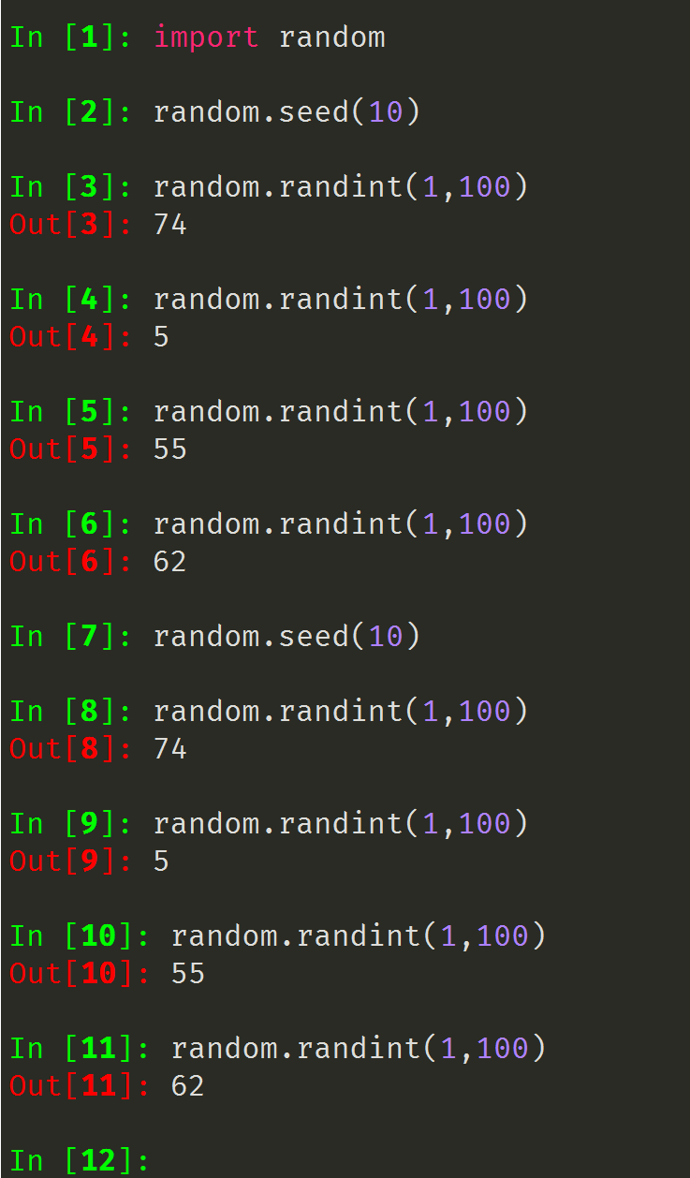

Slide 76
Writing Your Own Value-Returning Functions

Slide 78
Hal owns a business named Make Your Own Music, which sells guitars, drums, banjos, synthesizers, and many other musical instruments. Hal’s sales staff works strictly on commission. At the end of the month, each salesperson’s commission is calculated according to Table.
Because the staff gets paid once per month, Hal allows each employee to take up to $2,000 per month in advance. When sales commissions are calculated, the amount of each employee’s advanced pay is subtracted from the commission. If any salesperson’s commissions are less than the amount of their advance, they must reimburse Hal for the difference. To calculate a salesperson’s monthly pay, Hal uses the following formula:
pay = sales * commission rate - advanced pay

Slide 79
Hal has asked you to write a program that makes this calculation for him. The following general algorithm outlines the steps the program must take.
Get the salesperson's monthly sales.
Get the amount of advanced pay.
Use the amount of monthly sales to determine the commission rate.
Calculate the salesperson's pay using the formula previously shown. If the amount is negative, indicate that the salesperson must reimburse the company.

Slide 80
Returning Strings

Slide 81
Returning Boolean Values
Python allows you to write Boolean functions, which return either True or False.

Slide 82
Returning Multiple Values
In Python, however, you are not limited to returning only one value. You can specify multiple expressions separated by commas after the return statement.
return expression1, expression2, etc.

Slide 84
The math Module
The Python standard library’s math module contains numerous functions that can be used in mathematical calculations.

Slide 86
The math.pi and math.e Values
The math module also defines two variables, pi and e, which are assigned mathematical values for pi and e.
area = math.pi * radius**2

Slide 87
Storing Functions in Modules
A module is a file that contains Python code.
Large programs are easier to debug and maintain when they are divided into modules.
When you break a program into modules, each module should contain functions that perform related tasks.
If you have written a set of functions that are needed in several different programs, you can place those functions in a module.
Then, you can import the module in each program that needs to call one of the functions.

Slide 88
Let’s look at a simple example. Suppose your instructor has asked you to write a program that calculates the following:
The area of a circle
The circumference of a circle
The area of a rectangle
The perimeter of a rectangle
circle.py

Slide 89
rectangle.py
we should mention the following things about module names:
A module’s file name should end in .py. If the module’s file name does not end in .py, you will not be able to import it into other programs.
A module’s name cannot be the same as a Python key word. An error would occur, for example, if you named a module for.

Slide 91
Turtle Graphics: Modularizing Code with Functions
Commonly needed turtle graphics operations can be stored in functions and then called whenever needed.

